Slide 1


I.T INSTITUTE MANAGEMENT SYSTEM

Slide 2

I.T INSTITUTE MANAGEMENT SYSTEM
Projected By
Gouri S.Jadhav
Grishma M.Mali

Slide 3
INTRODUCION
Computers play avital role in one's life in today's generation.The software industry's most important aspect is"CHANGE" in theareas of software development and management.
Most importanttool are Maintainability,Reusability,Portability,Security,
Integrity and Use Friendliness.It has been pointed out that the rapid developement of technology is taken place in past few years.The most domainant example is COMPUTER.
computer wasfirstly only used in scientific purposes,but now the time has changed.Now in every field computers are the main source for
efficient and quick work done.

Slide 4
Earlier days the Institute, Office used to maintain admission records with lot of paper work which it very difficult to get the feedback whenever the record is needed.
This system aimsat the automation of the Admission Process and to reducethe papery work to make it easy for the officials to deal with theprevious records and also to make the easy entry of the new candidate to provide them the facilities.

Slide 5
EXISTING SYSTEM
In existing sysytem they maintained each record manually.These records are,such as granting of admission,Existing record,cancelling of admission and mainting of fees record
In granting of admission,modifing admission details and keeping up to date information of fees status personal detailsand other details are accepted though paper work only,it increses paper work ans it is difficult to retirve any record easily.

Slide 6
DRAWBACKS
In the exisiting system these are some drawbacks such as:
The exisiting system is time consuming process as the student
has to go through lengthy admission and payment of fees process.
In this system there is requirment manpower.so that economically this sysytem is more costly.
For the Transaction more paperwork is required.
To overcome these drawbacks or problems in manual system computerization is important.so we have tried to develop admission sysytem,which minimising thepaperwork save the time.

Slide 7
OBJECTIVES:
There are following objectives of proposed system:
Creation of paperless office ie.paperwork is reduced in the office.
The time is also reduced by proposed system.
The manpower is reduced by this system all the work of registering,issuing is done singal handeling.
The most important objective is a security.

Slide 8
SYSTEM STUDEY

Slide 9
Scope of project
This system has student ,batch, course , etc. entering . output is in form ofbill.
There is a one central computer where all database is stored.
This system is fully works on access control system.
As well as we can accessing , modifying ,&deleting the student, course ,
batches ,teacher record& also get output by Receipt system.

Slide 10
Modules of The System:
At record adding side
This system is useful for adding new Record of teacher , batches, student,
course.When anew student, teacher, batches, course have adding the field to every student, teacher, batches, course have given the id number.
This id is permanently granted to that particular student, teacher, course, batch
Id checks admission & registered or not .

Slide 11
B) At record deleting side:
This system is useful for deleting unnecessary old record.
It is activated when student leave classes or any course should be outdated batch should be closed.
We can delete record (particular ) by entering id of that field id checks all database & registration storage . if id having old registration or data in database operate can delete that particular data from database
Operate delete all information of every field like teacher, student, course, batch etc.

Slide 12
C) At modifying record side:
this system is useful for modifying old record .
when generating old records as for updating fields we modifying new records or firstly it opened.
for modifying records we open it by particular id –no .
id checks all database and registration storage. if id having old registration or data in database operator can modify that particular data from database.
operator modify& save all information of every fields like student, teacher, batch, course.

Slide 13
D) At Receipt side
this system is also provide facility of Receipt .
operator can takes (accept) id from student.
operator enter this id in Receipt page.
at that time automatically all information of that student displayed on page.
depending by course taken by student Receipt is generated .
student pay this bill & operator gives the Receipt to student.

Slide 14
Advantages of Institute Management System
They are quick and easy to do.
The system helps by checking for errors.
There is no risk that the application will get lost in the post.
Details on the application can be changed right up until the closing date.
The system has a series of security procedures which will prevent anyone seeing information they are not entitled to see.

Slide 15
Hardware Requirements
Sr.No. | Name | Description
1 | Processor | Pentium 4,3.04GHz
2 | Hard Disc | 80 GB
3 | RAM | 256 MB
4 | Monitor | LG
5 | Printer | Laser

Slide 16
Software Requirements
Sr.No. | Name | Description
1 | Operating System | Windows XP
2 | Language | Java(jdk1.6.0_01)
3 | DataBase | Microsoft Access

Slide 17
INTERFACE DESIGN

Slide 18
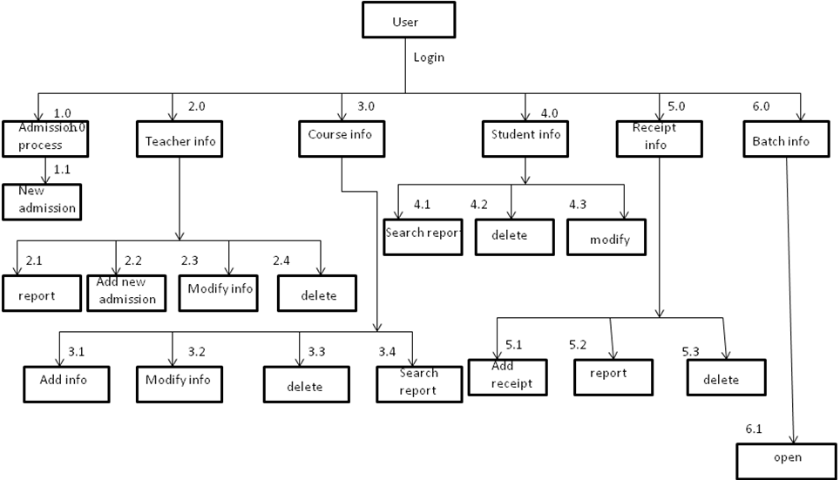
Functional Decomposition Diagram

Slide 19
Gender
Id
name
Ph-no
add
M
Student
M
M
Have
select
teaches
Co-period
b-time
B-Id
O
Co-name
M
Course
M
have
Batch
O
Co-fees
Taken by
have
M
O
Ph-no
Teacher
O
Gender
Tea-id
Tea-name
Tea-add

Slide 20
Context Level Diagram
Provide student details
Teacher information
Student
Teacher
Computer institute
Of management
Student & batch information
Give course detail & bill
Batch & course information
Course information
Batch
Course
Student & teacher information
Course & teacher information
CONTEXT LEVEL-DIGRAM

Slide 21
DFD FOR NEW ADMISSION
User
Details
sStudent
Details
1.1
New admission
process
Student data base

Slide 22
DFD FOR PAYMENT PROCESS
student
Receipt
User
Receipt
Login
Details
1.2
Payment
Receipt data base

Slide 23
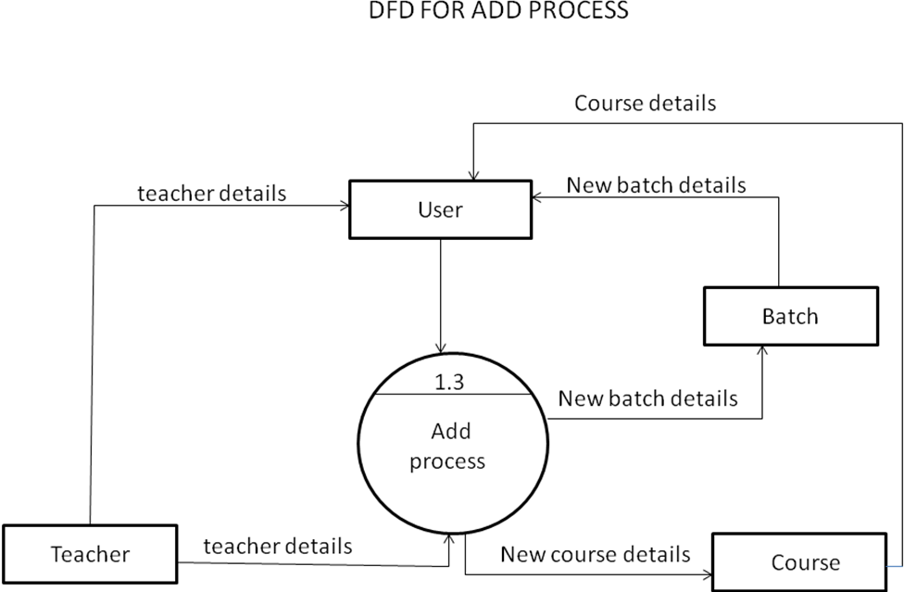

Slide 24
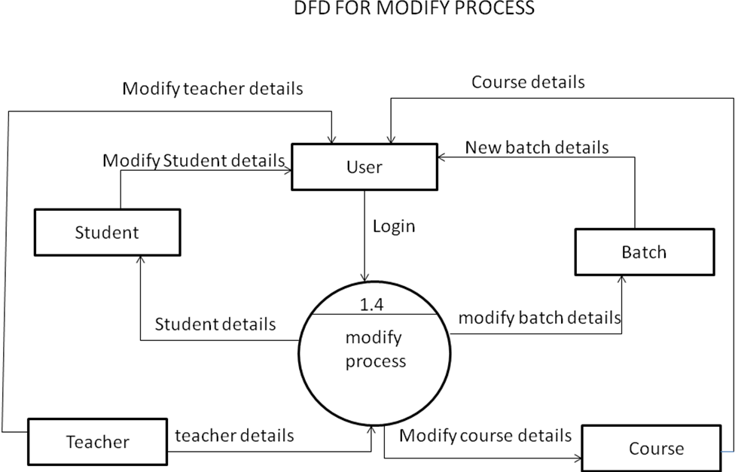

Slide 25
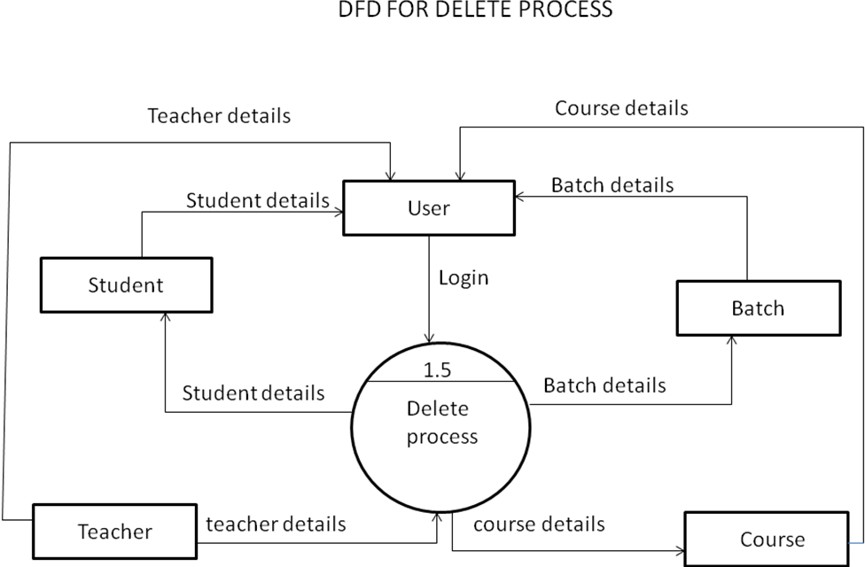

Slide 27
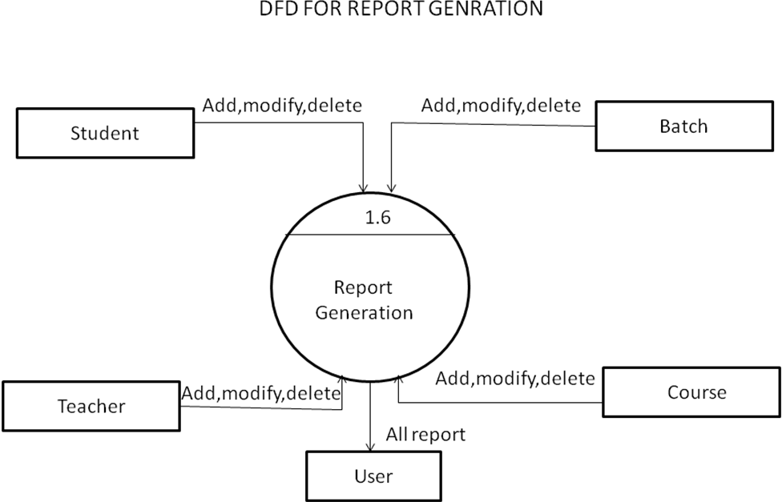

Slide 28
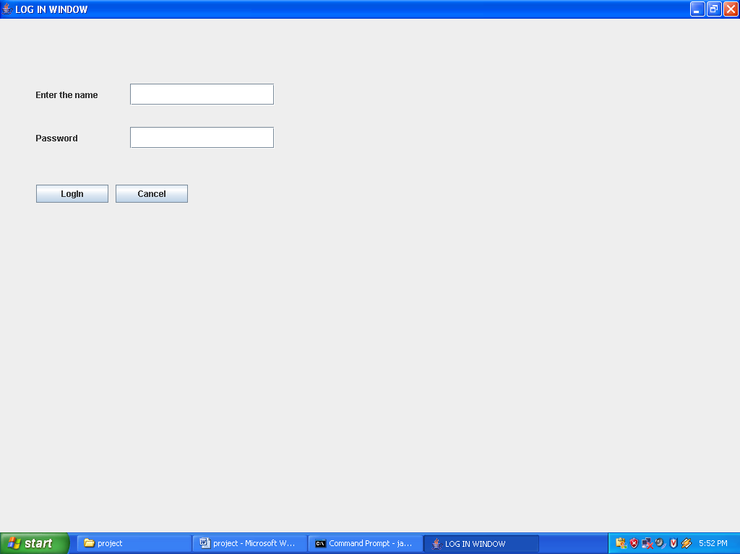
Login Screen :-

Slide 29
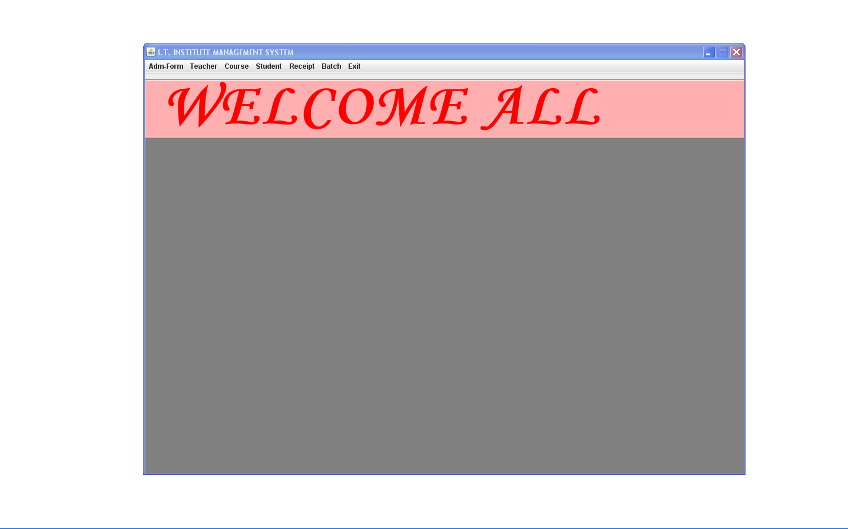
Main Screen :-

Slide 30
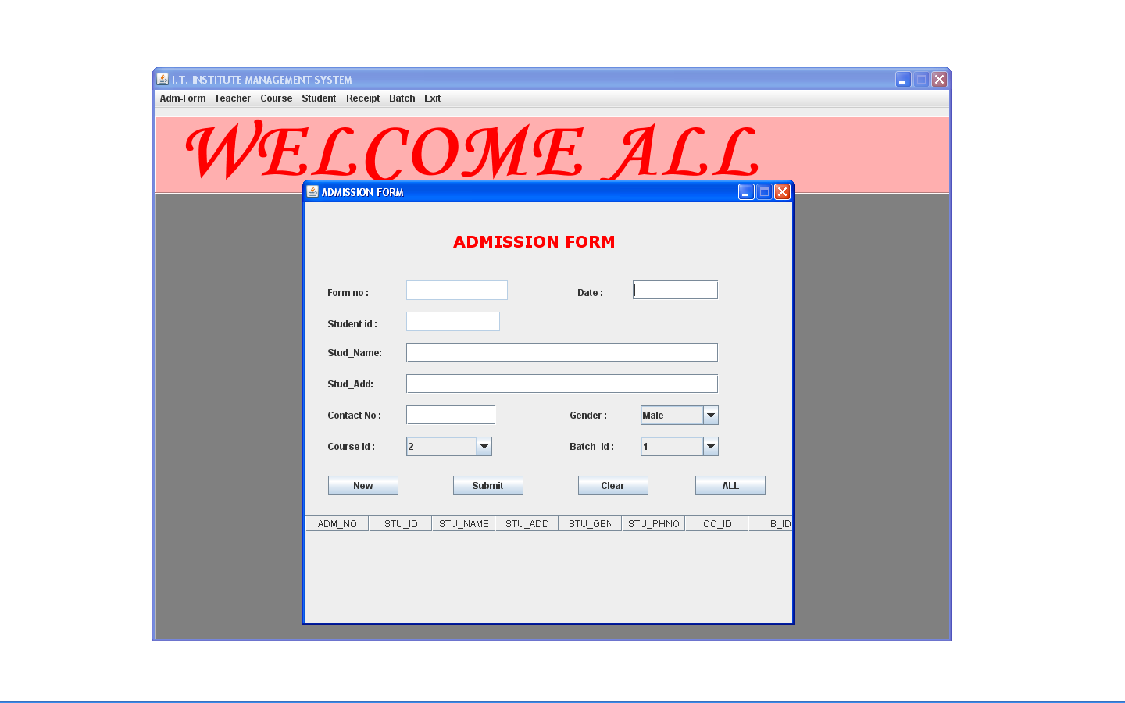
Admission form

Slide 31
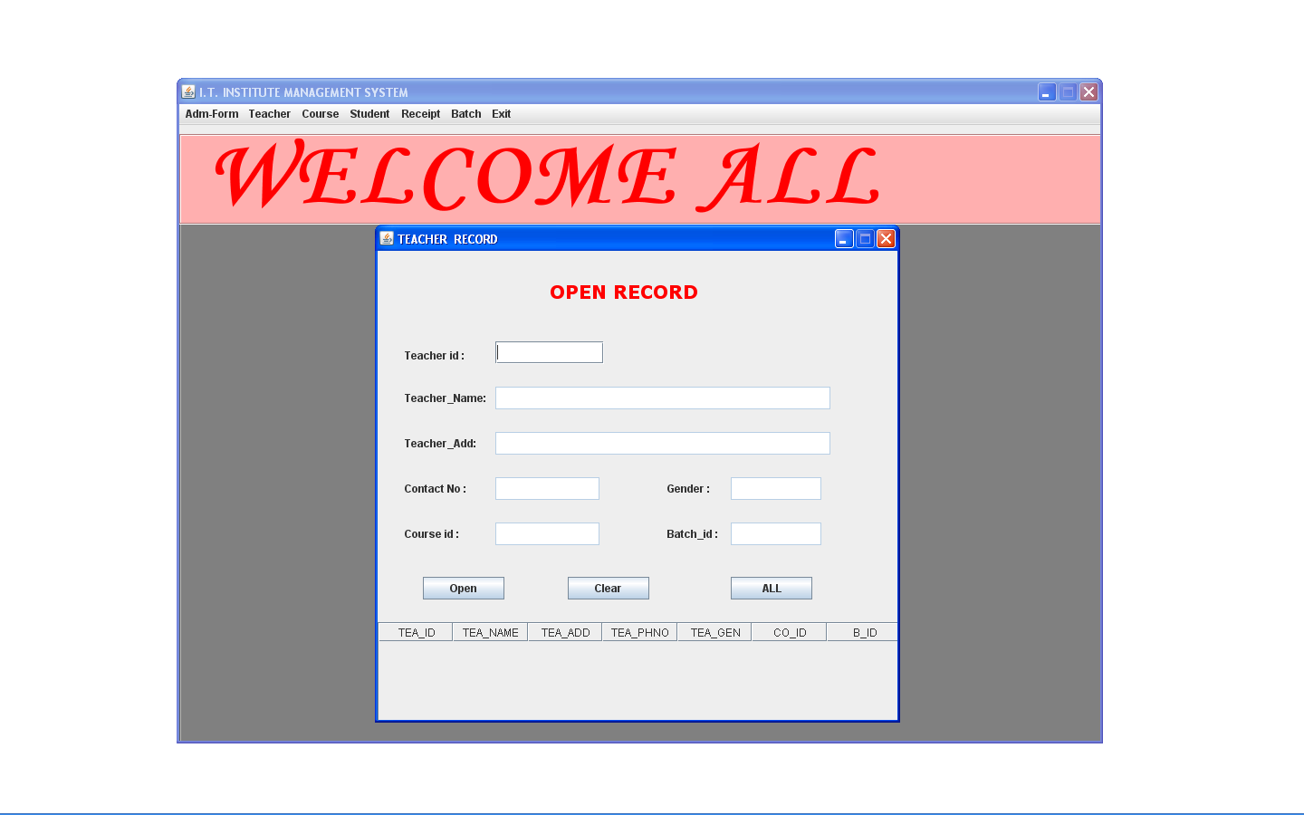
Open teacher record

Slide 32
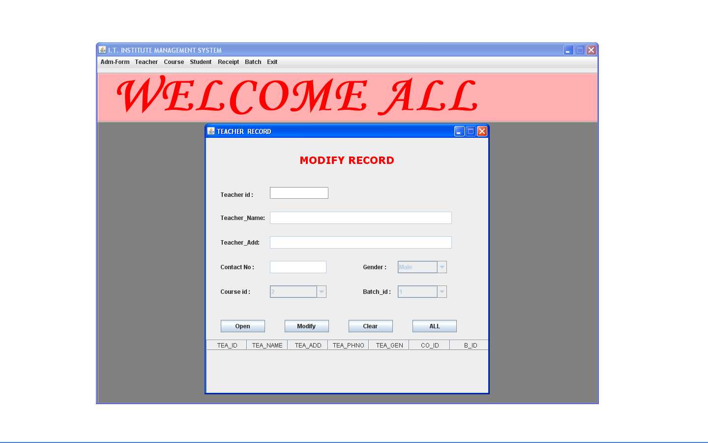
Modify teacher record

Slide 33
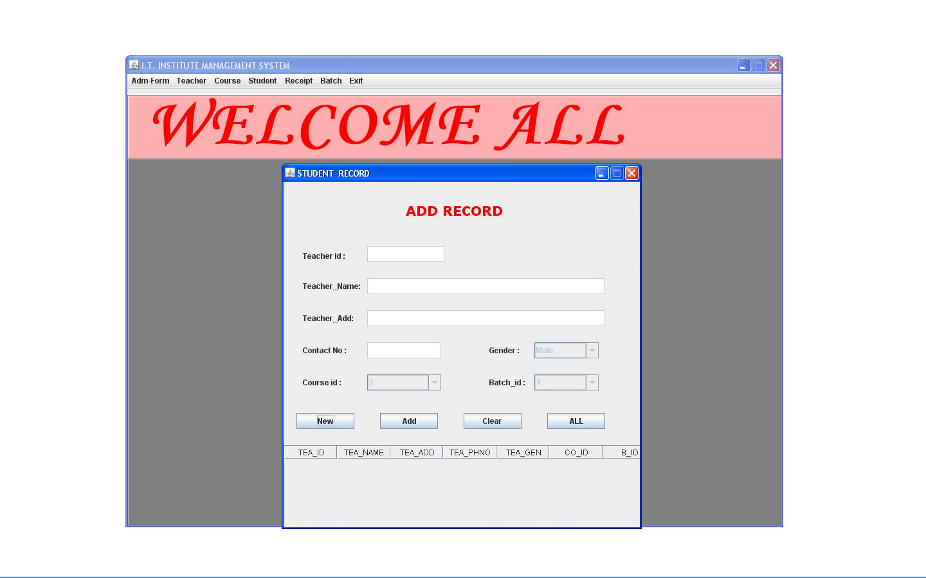
Add teacher record

Slide 34
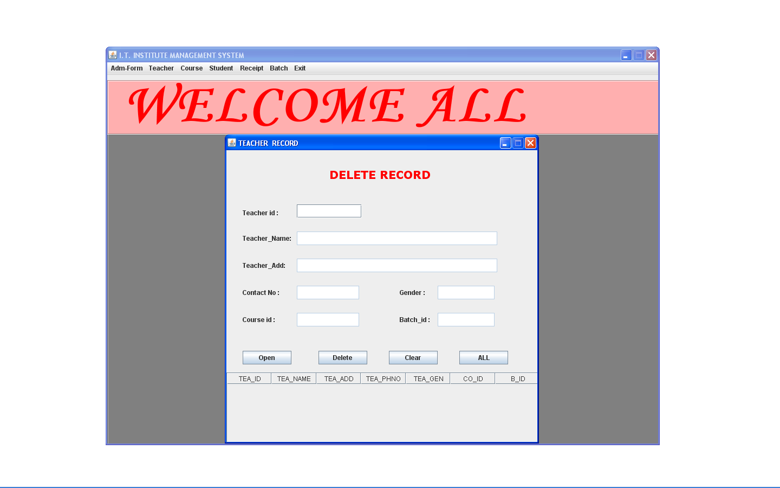
Delete teacher record

Slide 35
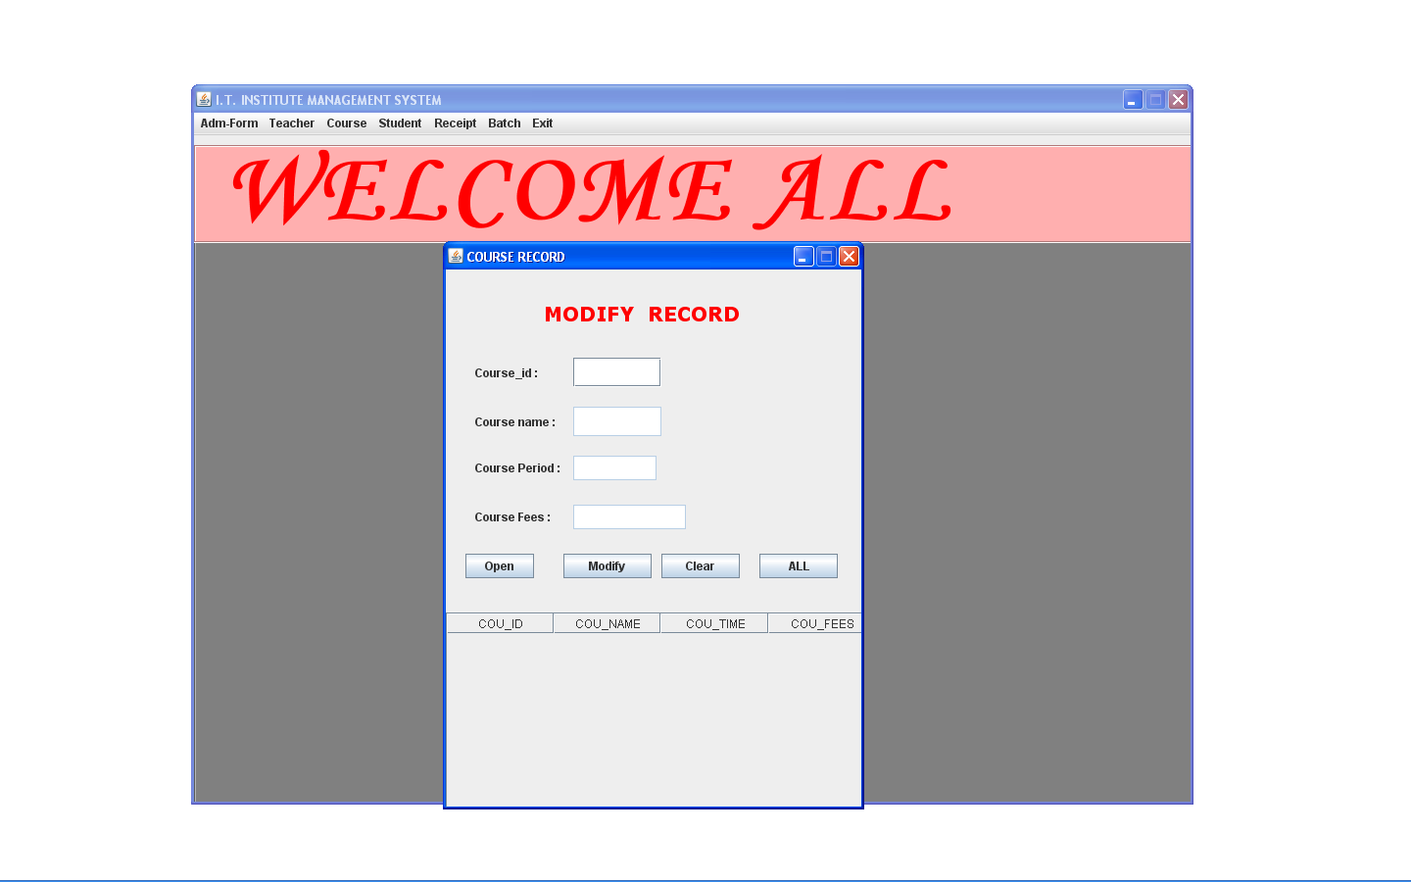
Modify course record

Slide 36
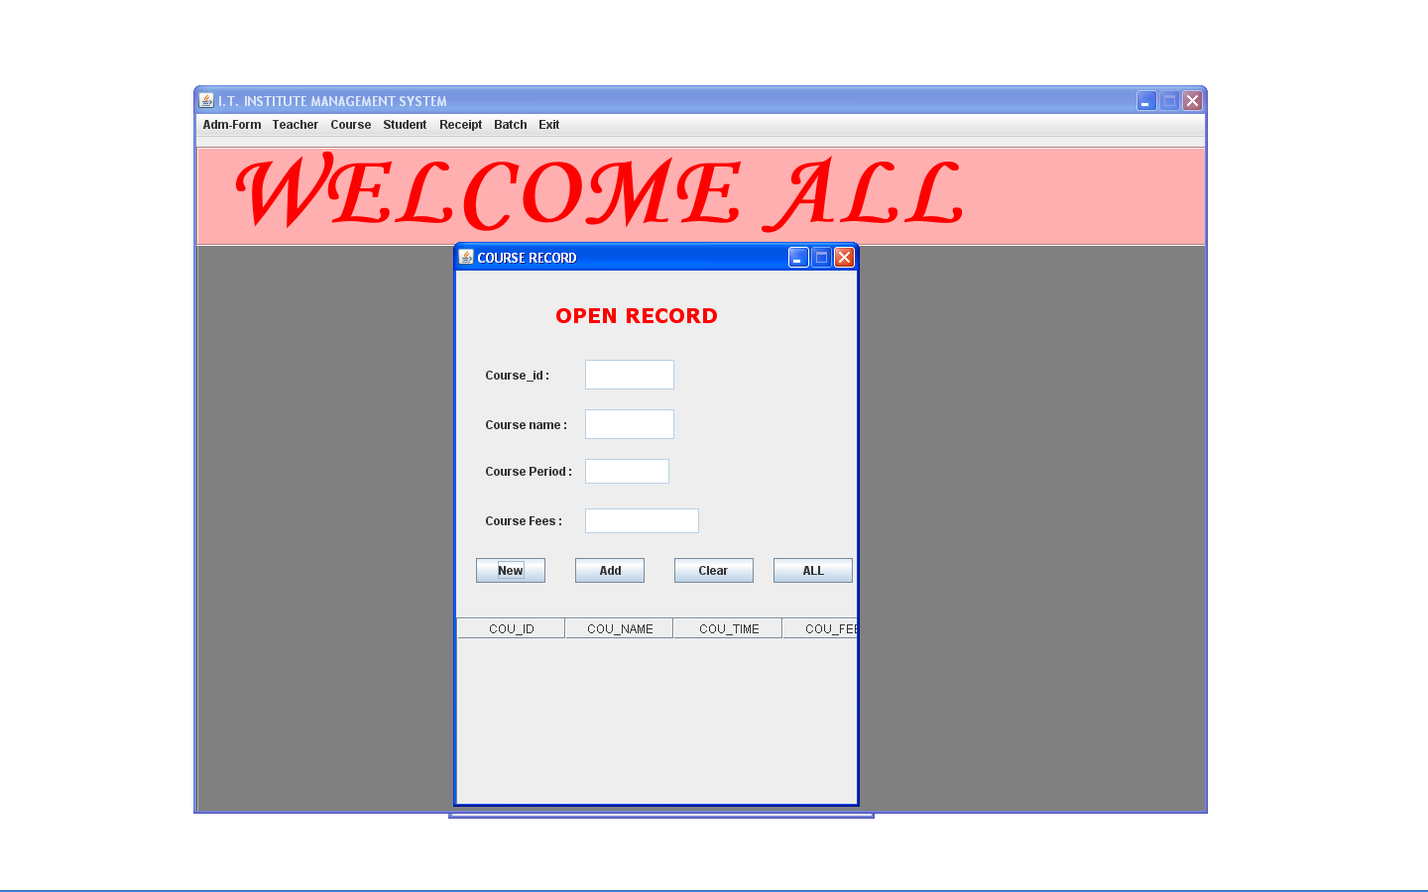
OPEN course record

Slide 37
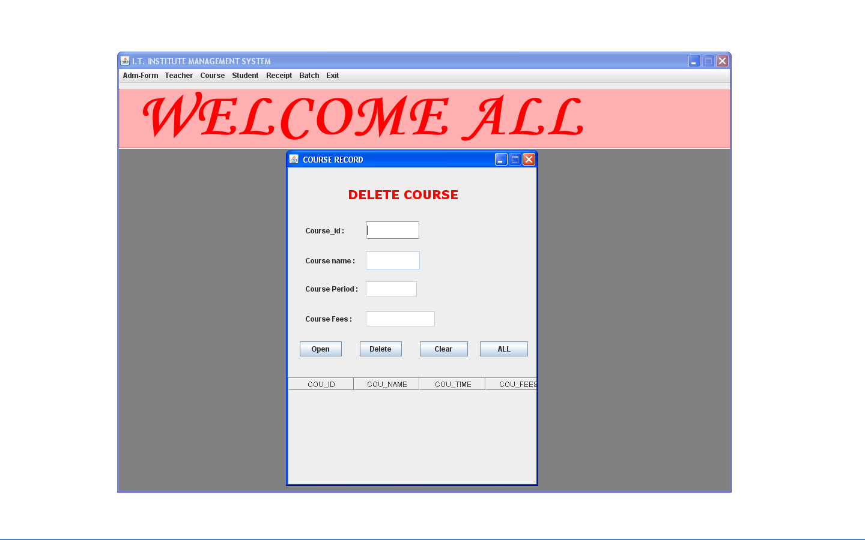
Delete course record

Slide 38
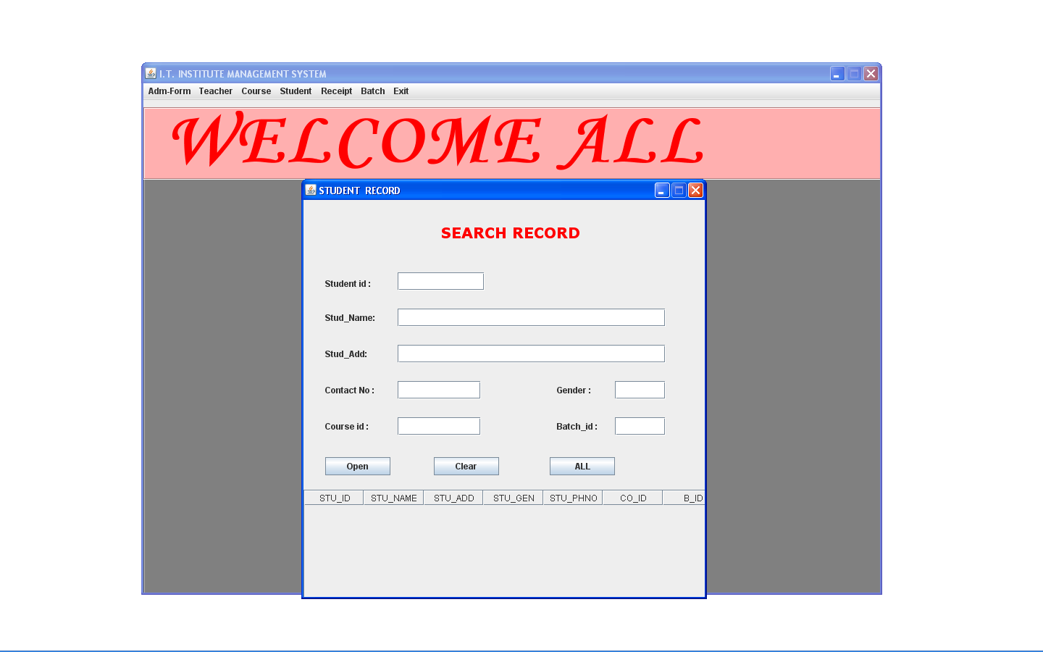
SEARCH STUDENT RECORD

Slide 39
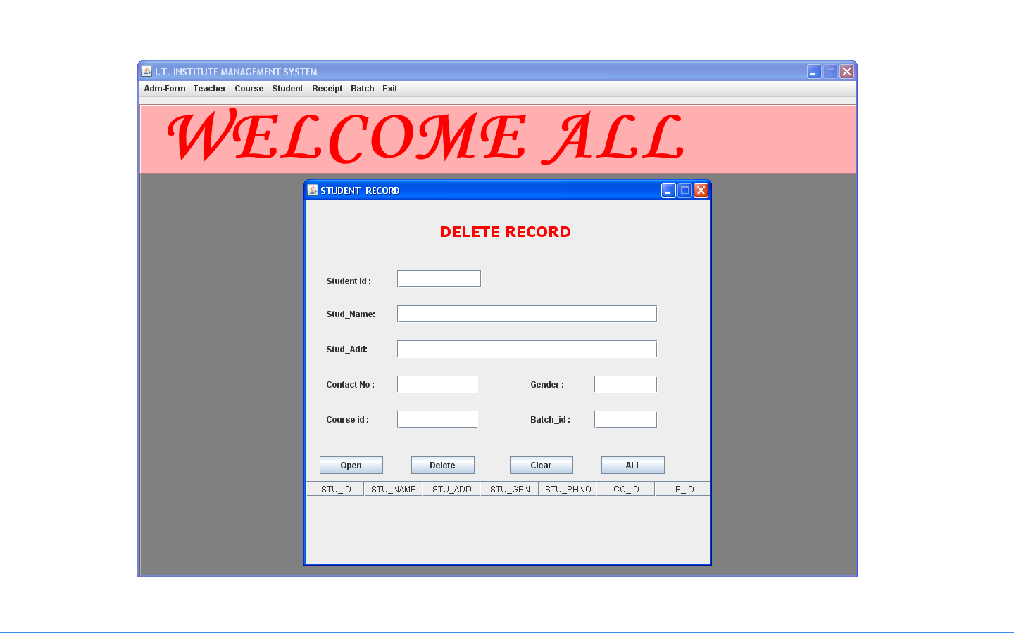
DELETE STUDENT RECORD

Slide 40
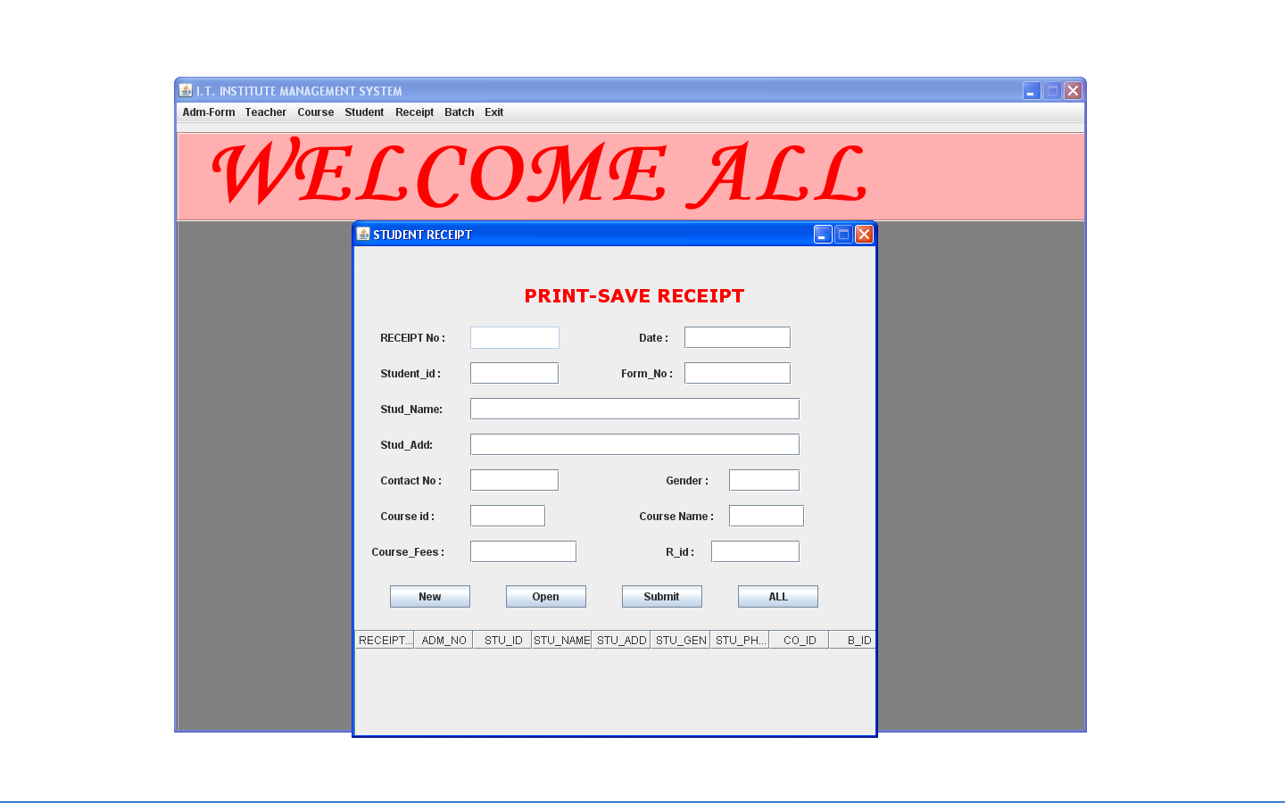
ADD RECEIPT

Slide 41
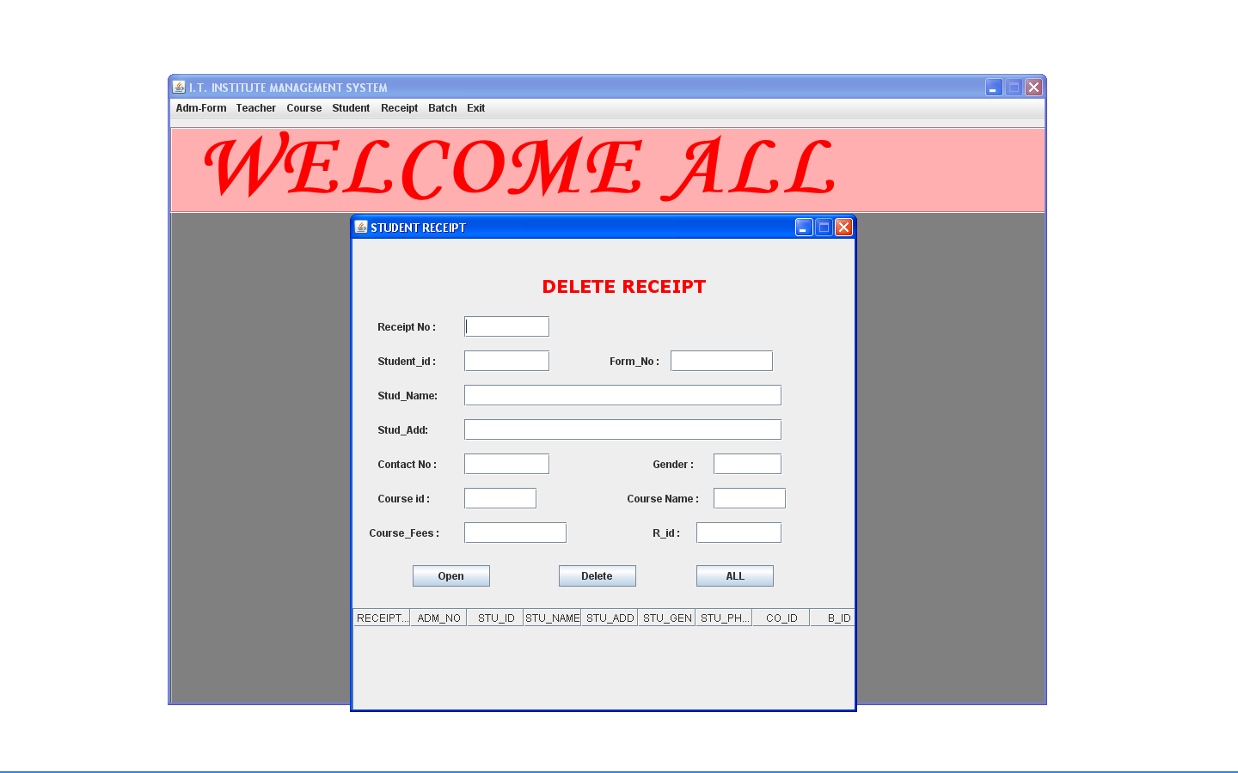
DELETE RECEIPT

Slide 42
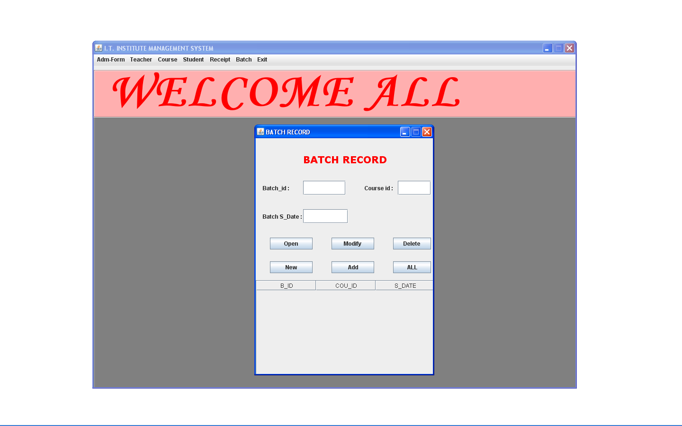
ADD BATCH RECORD

Slide 43
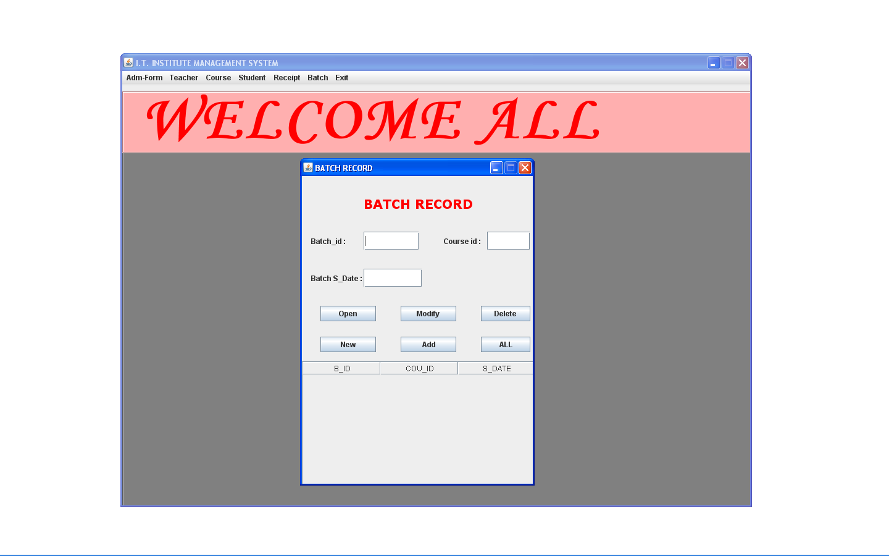
DELETE BATCH RECORD

Slide 44
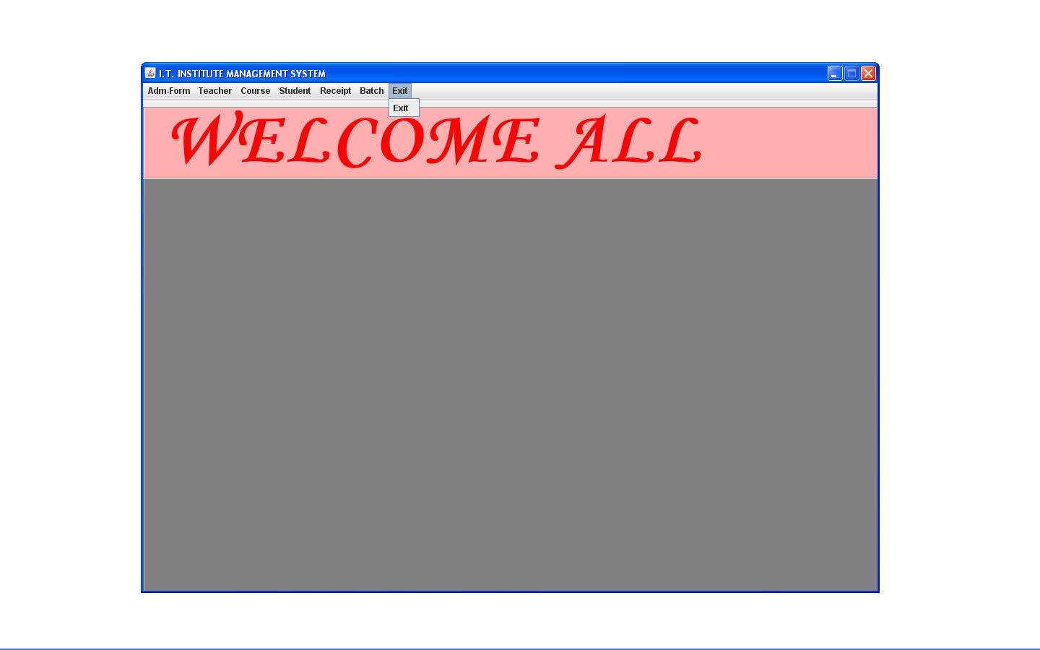
` EXIT WINDOW

Slide 45
Limitations
Our system may become obsolete as in computer industry, technological developments are very fast, new software, new utilities may obsolete this system.
System security is password dependent, if secrecy about password information is not maintained, system could be in great danger.
This system is constructed and developed for text environment so pack gives best appearance and performance under text environment but poor appearance on GUI environment.
System requires electricity to function, absence may result in chaotic situation in the an organizational procedures.

Slide 46
Conclusion
Using this Application user can issue fresh admission to interestedstudent.
Unique student number is issued to the students who have been granted the admission.
Using fees status application, we can give receipt of paid fees to the student .

Slide 47
THANK YOU

